Slide 1
Helping Our
Customers Win
Winning Together Honorably
Passionately Positively
Notes:
Welcome
Thank you for choosing to work at Aagard
Purpose plus values = Aagard experience

Slide 2
Agenda
Welcome / Introductions / Opening Prayer – Brad V. / Mark
“Business for Good” – Ryan Skoog
Aagard Ownership Transition / Generosity – Brad VanderTuin
Questions & Discussion
Aagard Team Presentation
Questions & Discussion
Tour of Aagard (Optional) – 10:30 a.m.
Depart – 11:00 a.m.

Slide 3
Business For Good
Ryan Skoog
Notes:
Welcome
Thank you for choosing to work at Aagard
Purpose plus values = Aagard experience

Slide 4
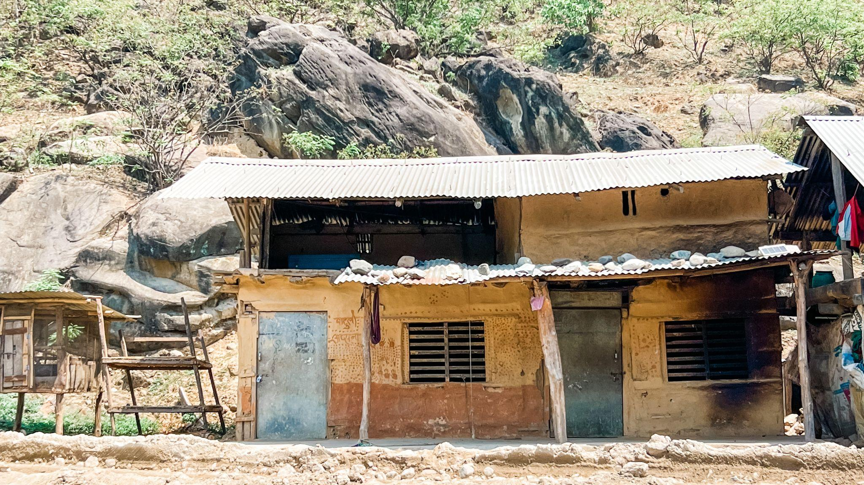


Slide 5
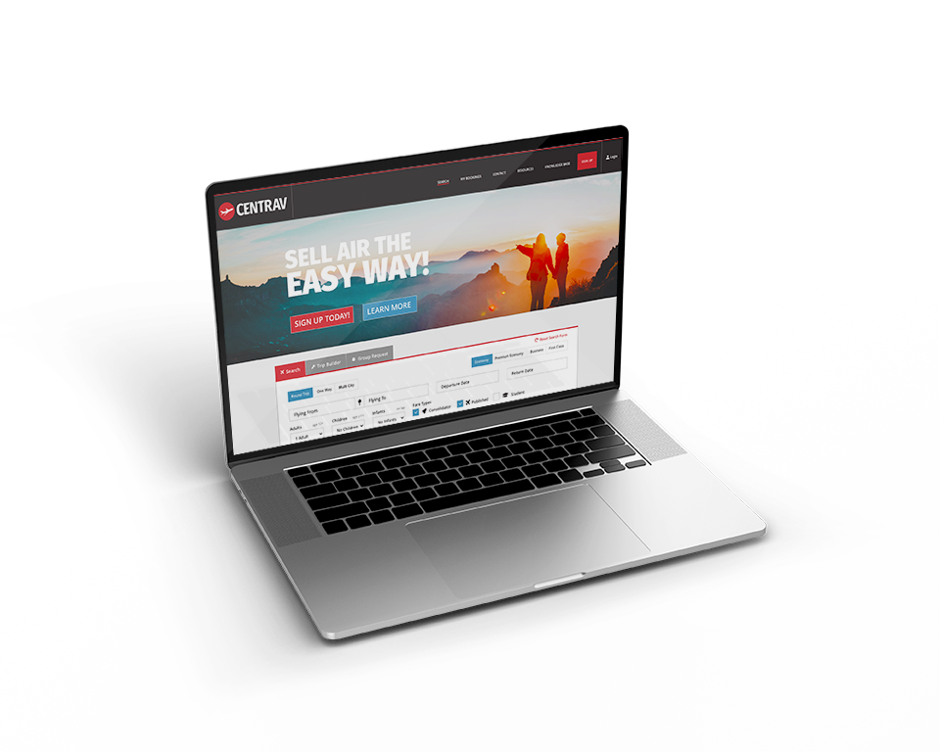


Winner of 5 Travvy Awards:
Best Consolidator in America
33 year Delta Air Lines partner
99% of bookings are made online, no book & queue
Proprietary, award-winning technology developed in-house
Notes:
99% of bookings are made online, no book & queue

Slide 6


Student groups
Humanitarian groups
Leisure groups
Most experienced group agents in America (18 years)
Notes:
99% of bookings are made online, no book & queue

Slide 7


Slide 8


Courage First
Then Miracles
Growing

Slide 9

HARVARD STUDY - ADULT DEVELOPMENT STUDY
SINCE 1938 - ALMOST 9 DECADES
MULTI SOCIOECONOMIC CLASSES
MULTIPLE GENERATIONS
CONCURS WITH PEW AND GALLUP POLLS OF THE SAME GENRE

Slide 10
HARVARD STUDY - ADULT DEVELOPMENT STUDY
FAITH
FAMILY
FRIENDS
MEANINGFUL LABOR

Slide 11
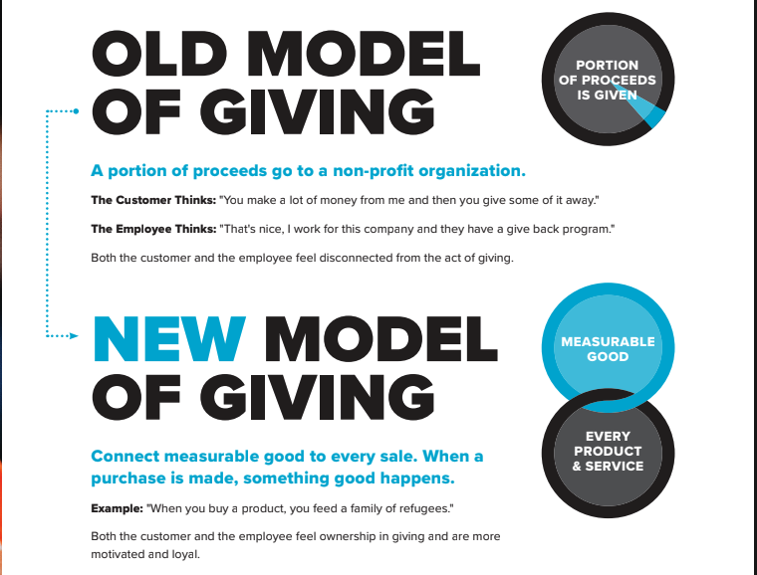

Slide 12
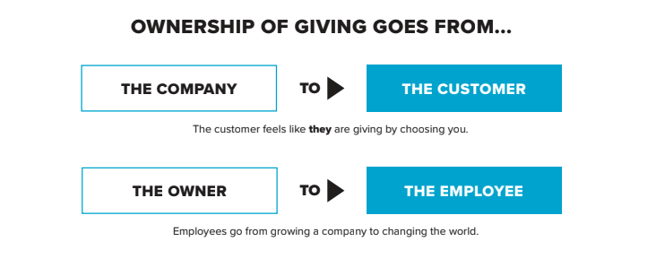

Slide 13
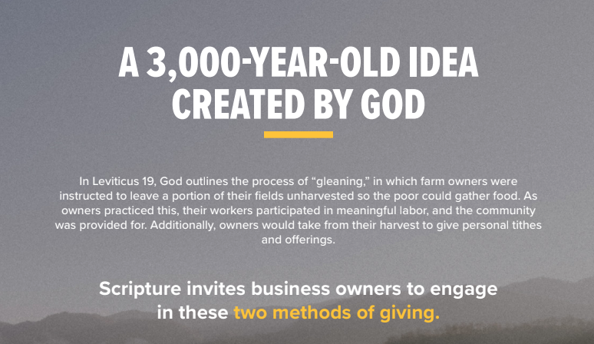

Slide 14


Slide 15


Slide 16
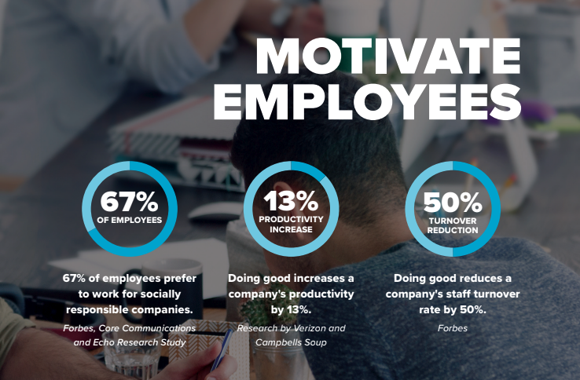

Slide 17
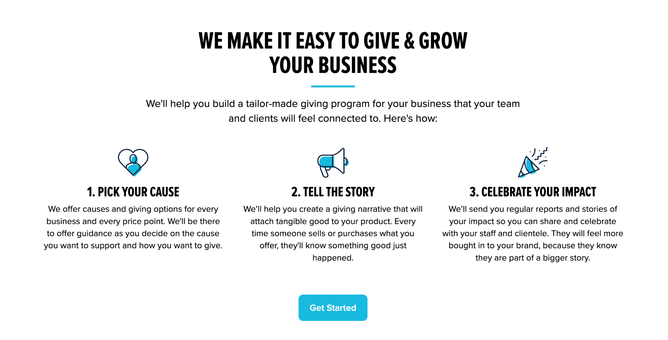

Slide 18


Slide 19


Slide 20
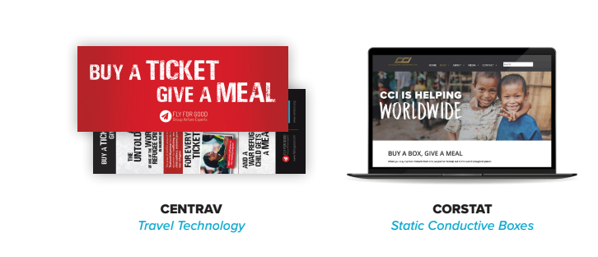

Slide 21
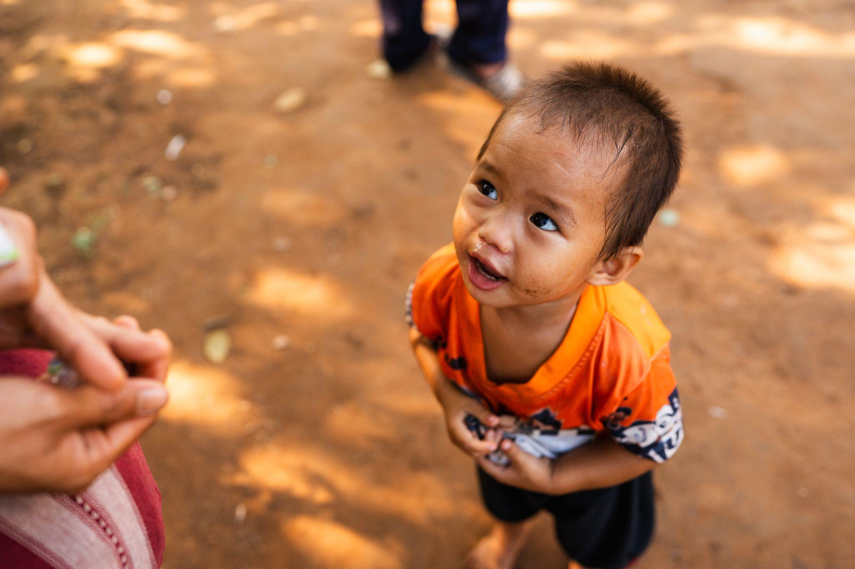

Slide 22
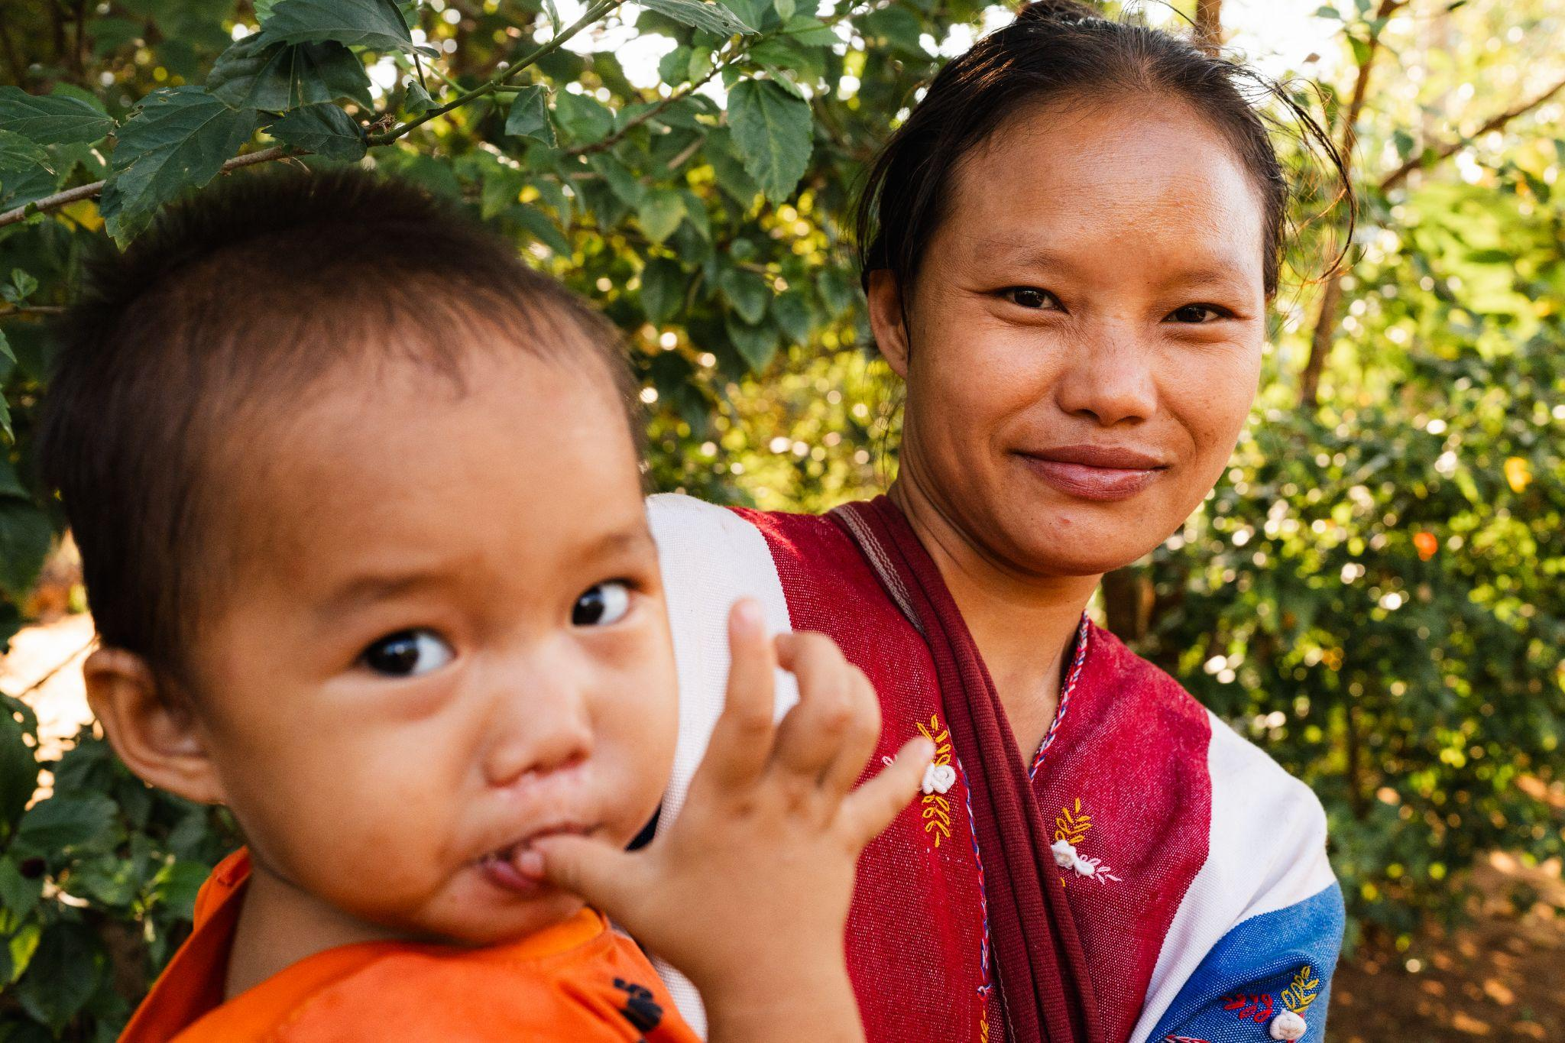

Slide 23
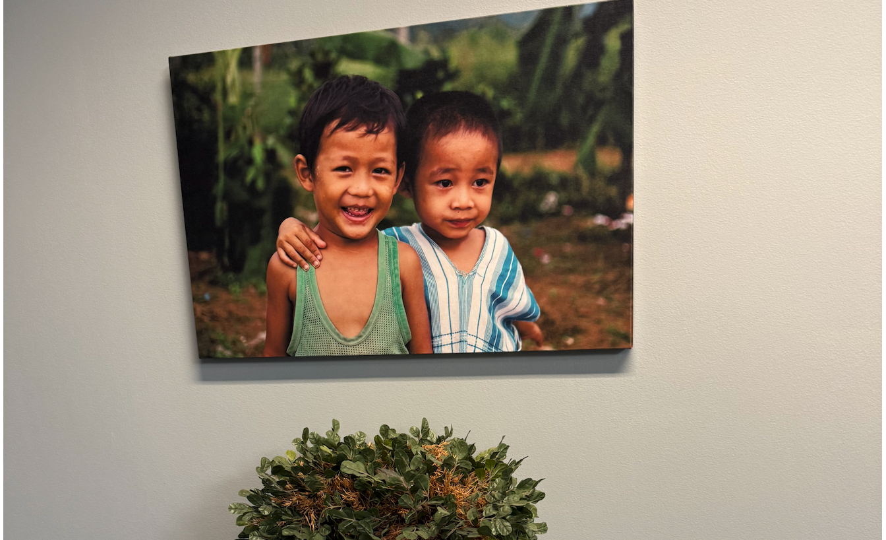
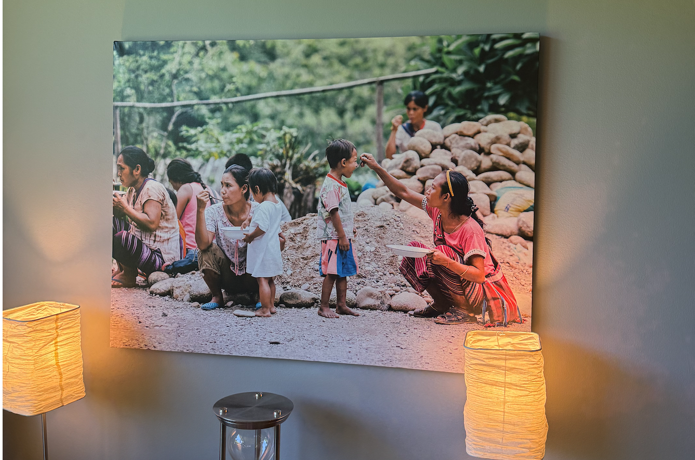
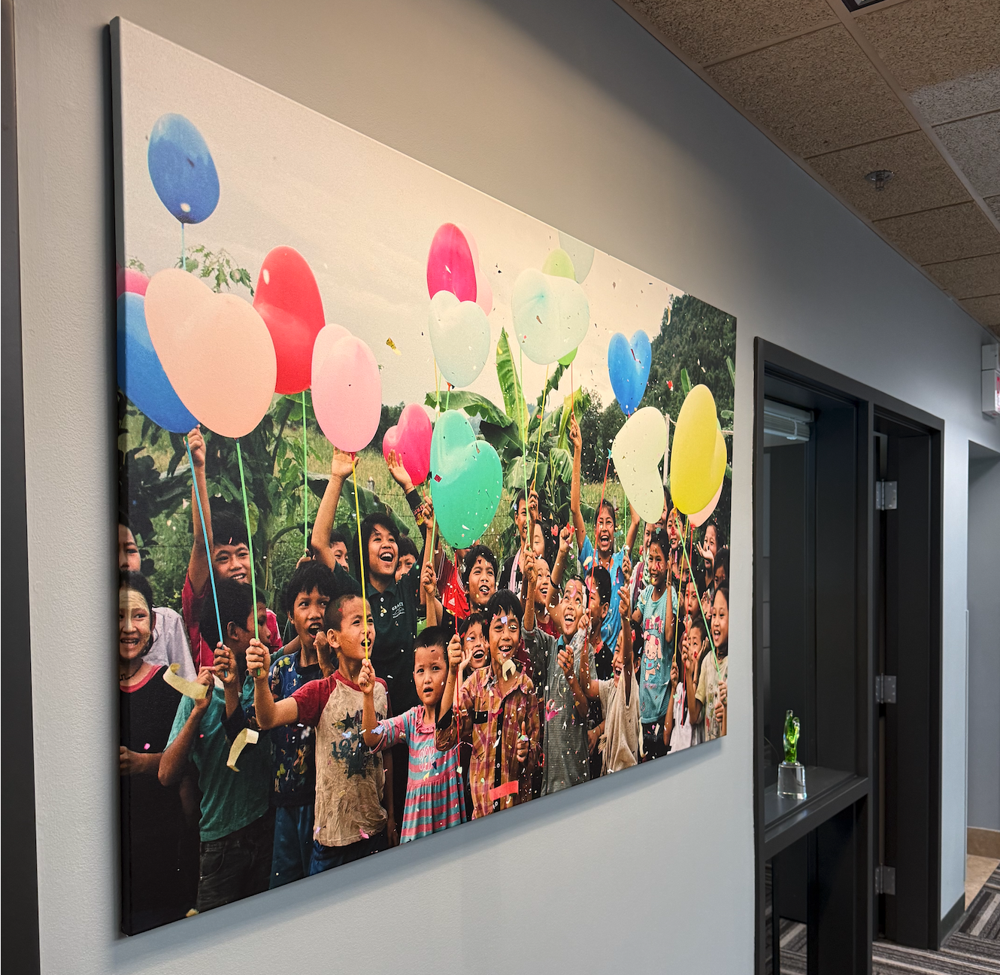

Slide 27


LeadWithPrayer.com
Fortingall Yew

Slide 28
RYAN@VENTURE.ORG
Fortingall Yew

Slide 29
Aagard Ownership Transition
Brad VanderTuin
Notes:
Welcome
Thank you for choosing to work at Aagard
Purpose plus values = Aagard experience

Slide 30
The Unknown
  What happens if….?
  What is Brent’s plan?
The Goals
  Protect Jobs
  Protect the Culture
  Be fair to the stakeholders

Slide 31
Expanded Goals
  Maximize Charitable Giving
  Minimize Taxes
  Maintain Local Control
  Reward the Team
  Train/Coach/Develop the Next Generation
  Keep it Simple
  No Debt
  Infinite Game
  Fair to the Stakeholders

Slide 32


A New Idea

Slide 33
Brent & Sally
100% Shares
Voting Trust
NCF
1% Voting Shares
99% Non-Voting Shares

Slide 34
Current State
  Methods
    Charitable Partnership Program (TM match)
    Weekend to Remember Marriage Conference
    Local Service Projects
    Corporate Giving
  Priorities
    Faith (Christian) based
    Local
    Education (with focus on career development related to Aagard needs)
    Connected with our team members (things they are involved with/giving to)
    Youth
    Arts/Community enrichment

Slide 35
Now What?
  How do we use this new arrangement for good?
  A community sharing ideas
    Impact Conference
    Goodness Gathering
    Corporate Generosity council

Slide 36
Future State
  Unknown...

Slide 37

Questions
&
Discussion

Slide 38
Aagard Presentation
Aagard Team
Notes:
Welcome
Thank you for choosing to work at Aagard
Purpose plus values = Aagard experience

Slide 39
About Aagard
Jason Norlien
Notes:
Welcome
Thank you for choosing to work at Aagard
Purpose plus values = Aagard experience

Slide 40
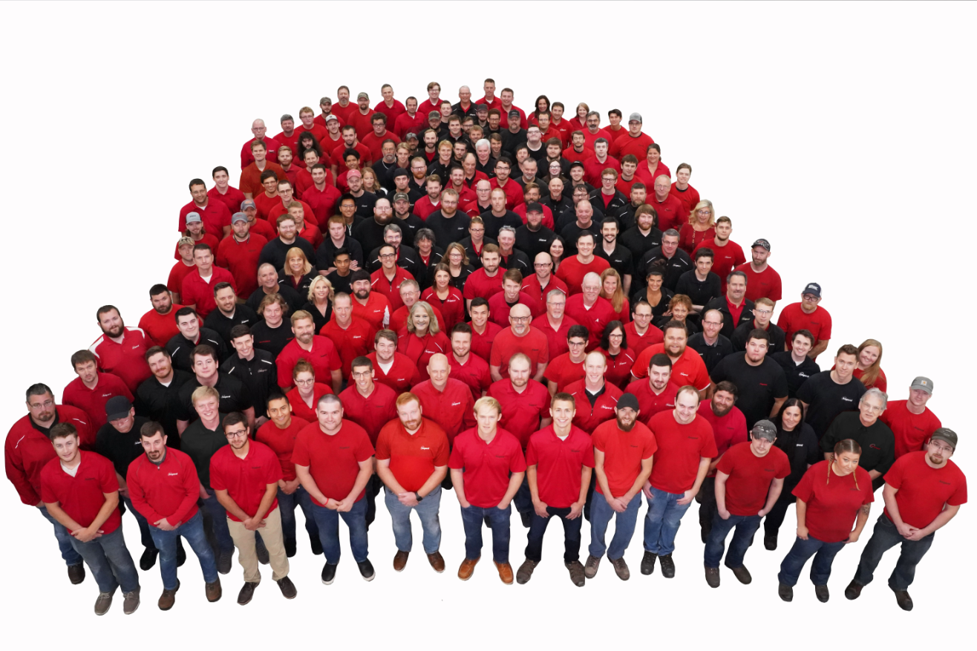
PURPOSE:
Helping Our Customers Win
Packaging automation optimized for space & capability
VALUES:
WINNING
TOGETHER
HONORABLY
PASSIONATELY
POSITIVELY
Notes:
delete

Slide 41
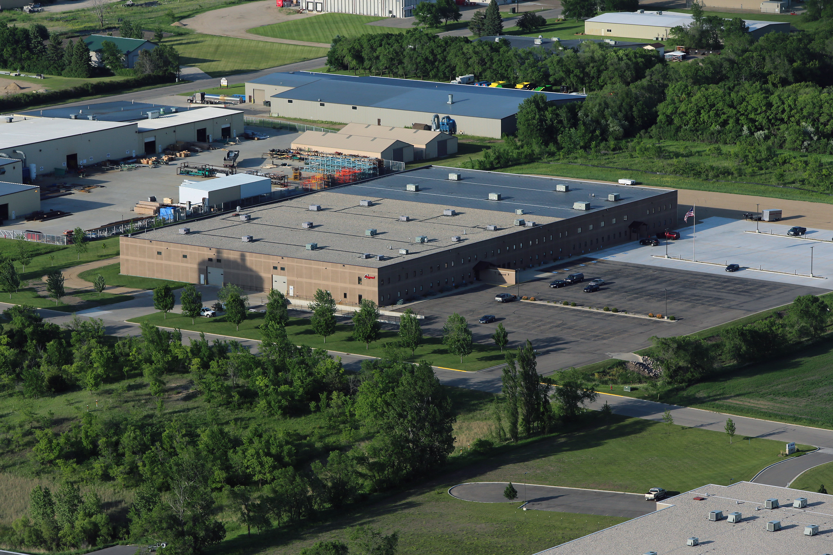
Who is Aagard?
Founded in 1997
$80MM revenue 2024
A Team of 340 Inventive Problem Solvers & Growing
115,000 ft² Facility in Alexandria, Minnesota
80,000 ft² Fabrication Center (also Alexandria)
Notes:
Invite them to come and visit!!

Slide 42
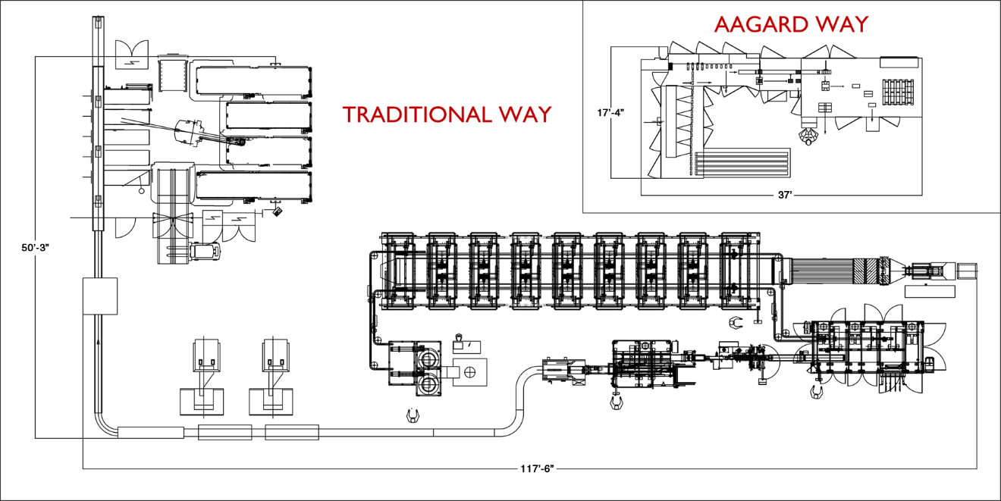
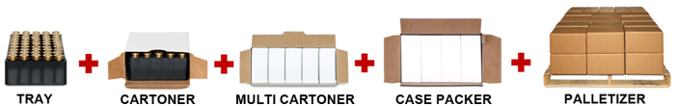
Case Study: Ammunition
Same Operation Shown To Scale

Slide 43
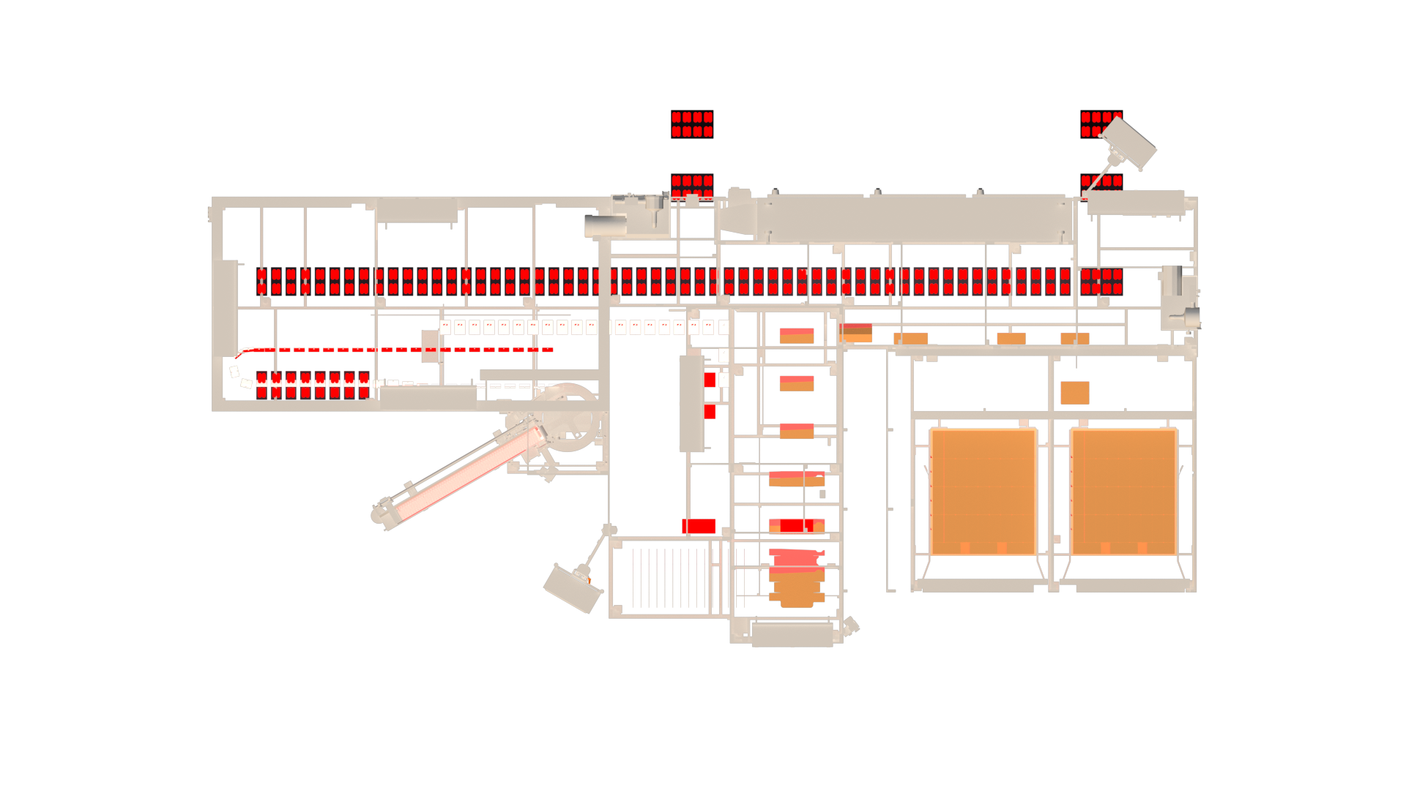
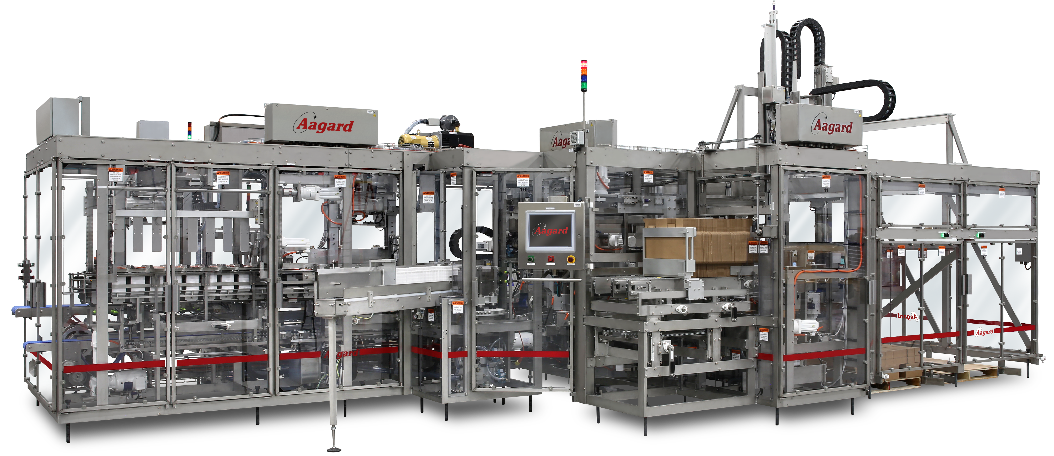
Tight on Space?
Turnkey System
We can help.
Cartoner
Case Packer
Dual Palletizer
Retail Ready
12’ 6”
31’

Slide 44
Combination Systems with Integrated Devices
Ultra Small Footprint Cartoner, Case Packer, Palletizer Combination System
Including Integrated:
Checkweigher
Metal Detection
Carton Printing
Case Labeling
Vision Inspection
12’ 6”
31’

Slide 45
Aagard Wheelhouse
Combination machines
  Many operations, small footprint
  Custom product handling
Projects $500,000 up to $5,000,000 per line
Critical path 6-12 months
Packaging Automation Optimized for Space and Capability
Notes:
Delete

Slide 46
Aftermarket Sales / Service
Average >200 retrofits per year
Collation and pack pattern changes
Size range and material changes
Safety and controls upgrades
Machine relocation and repurposing

Slide 47
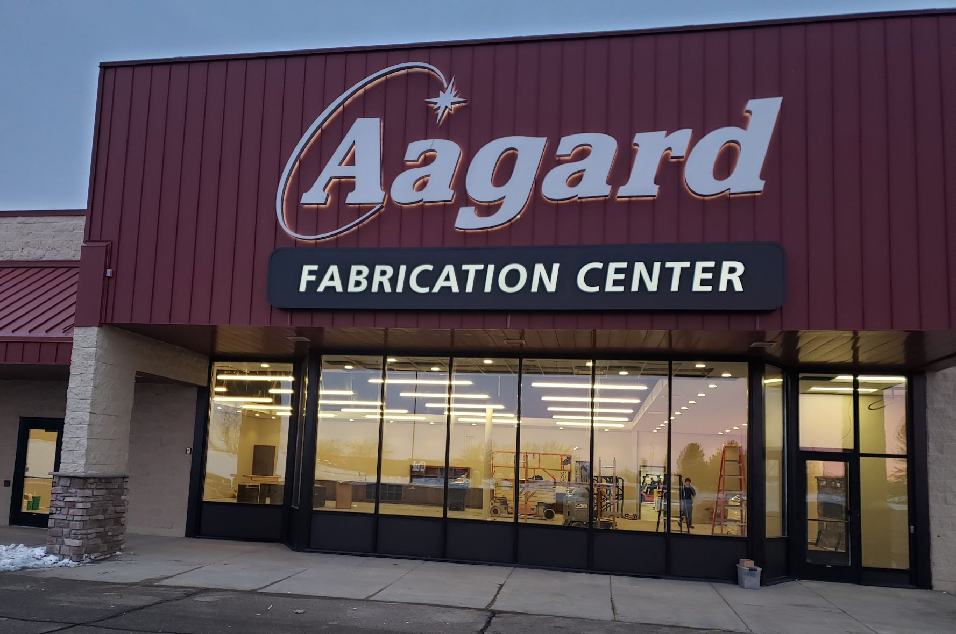

Slide 48
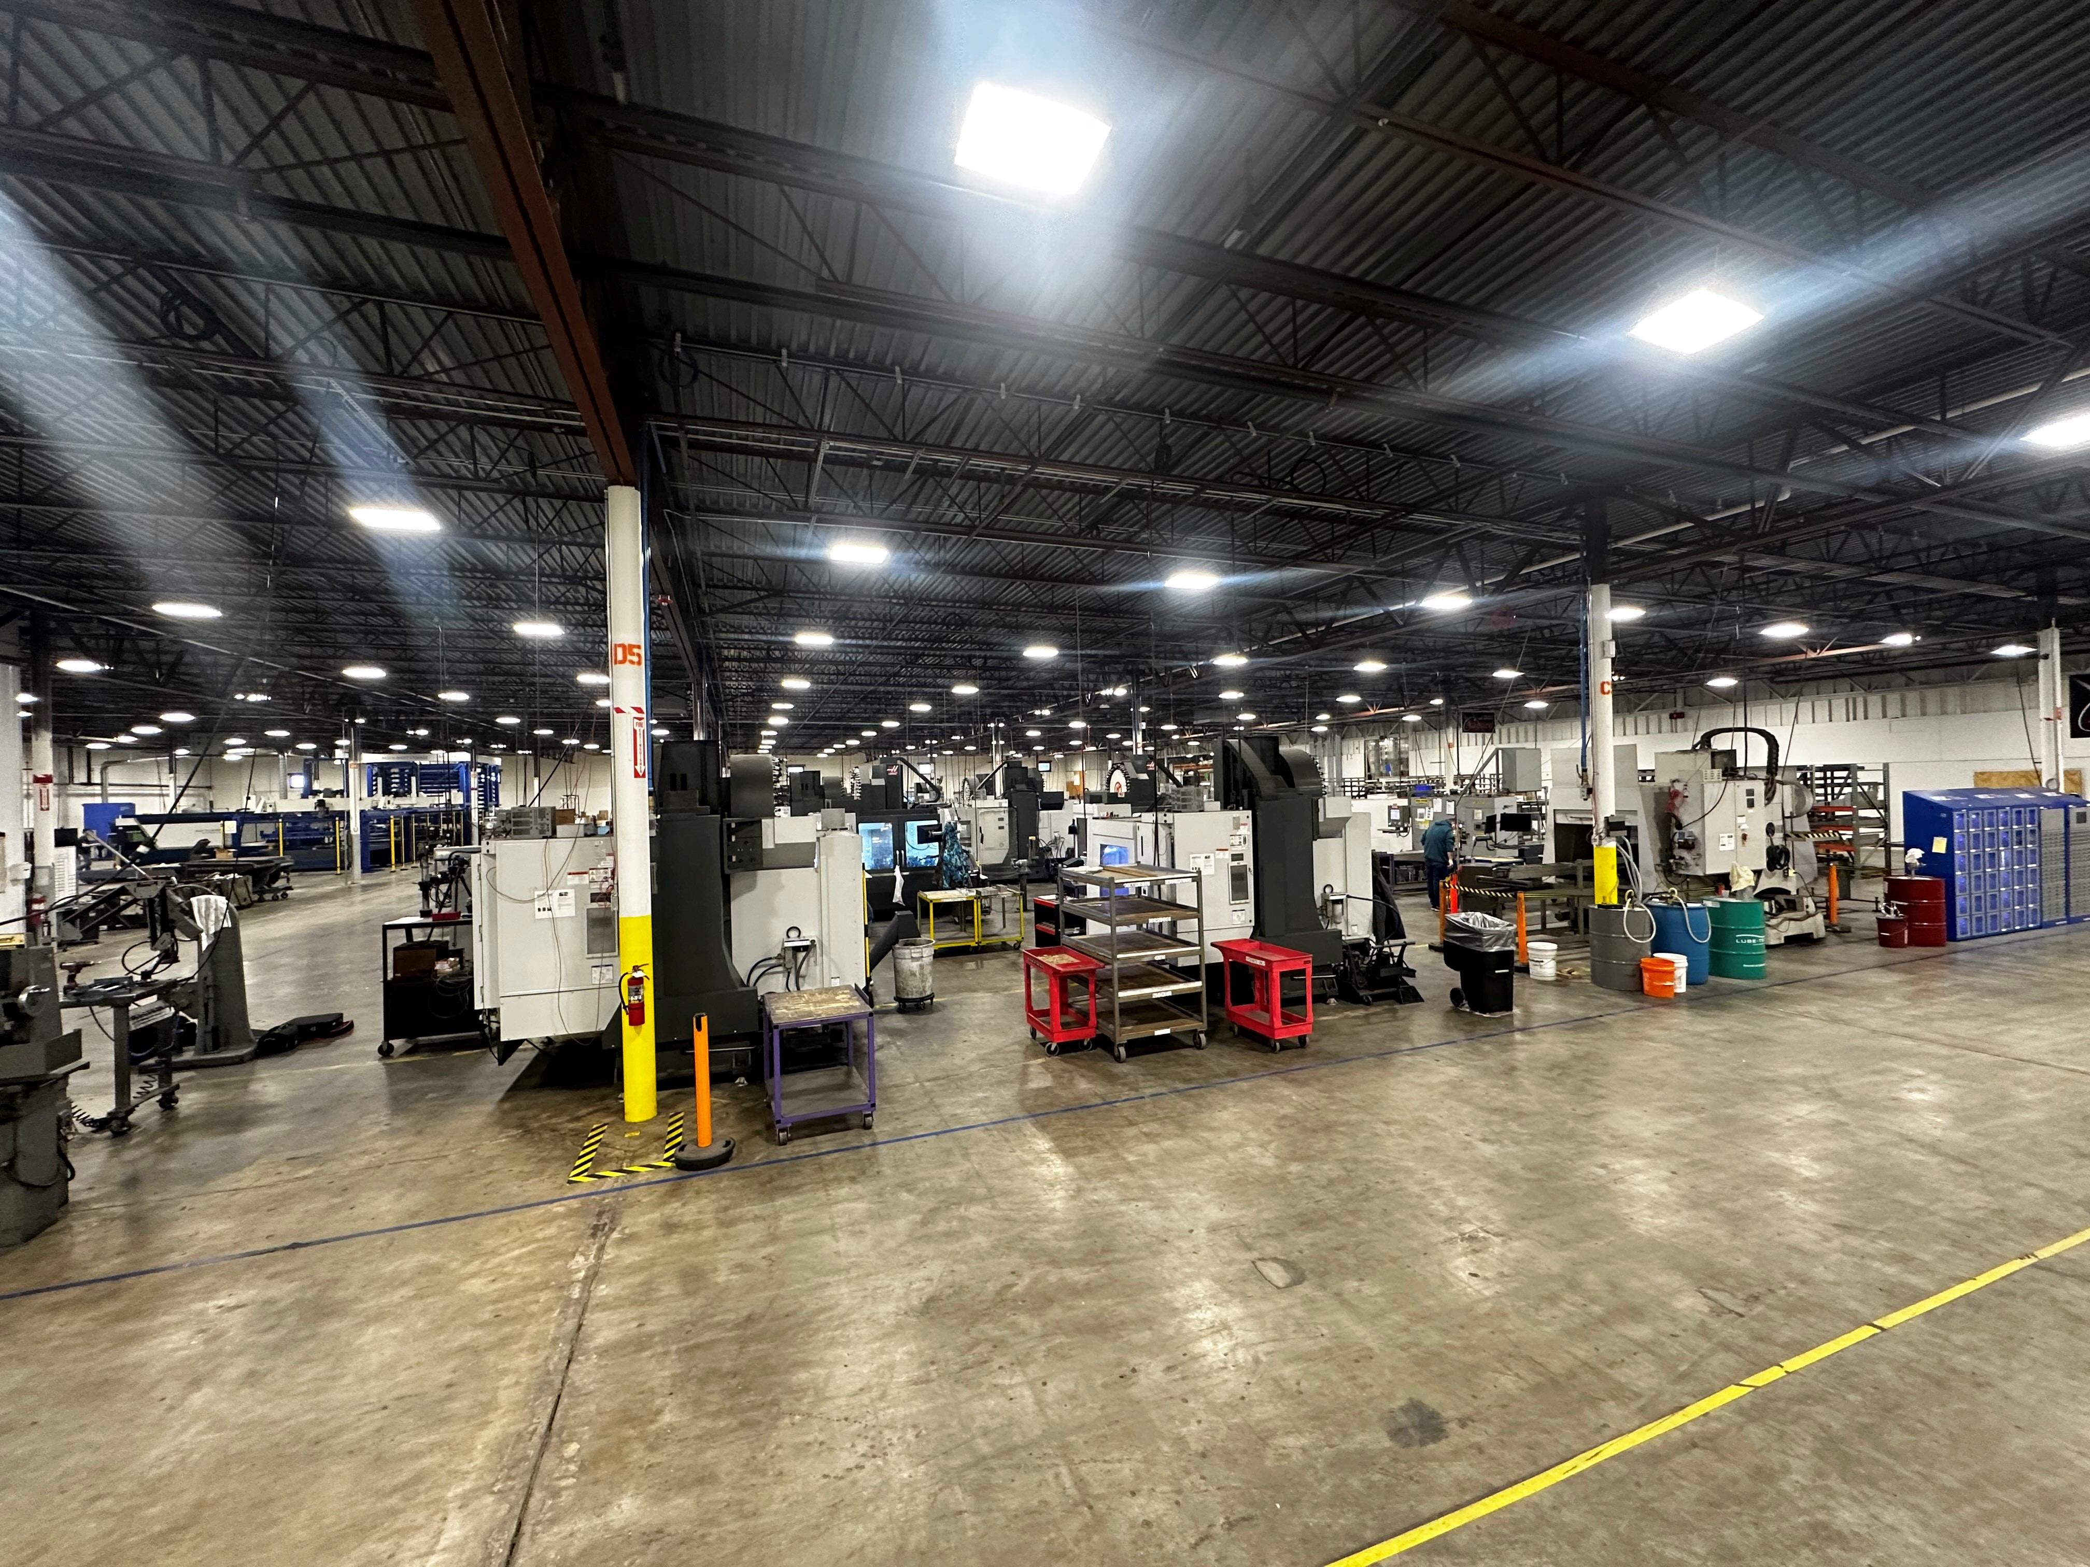

Slide 49
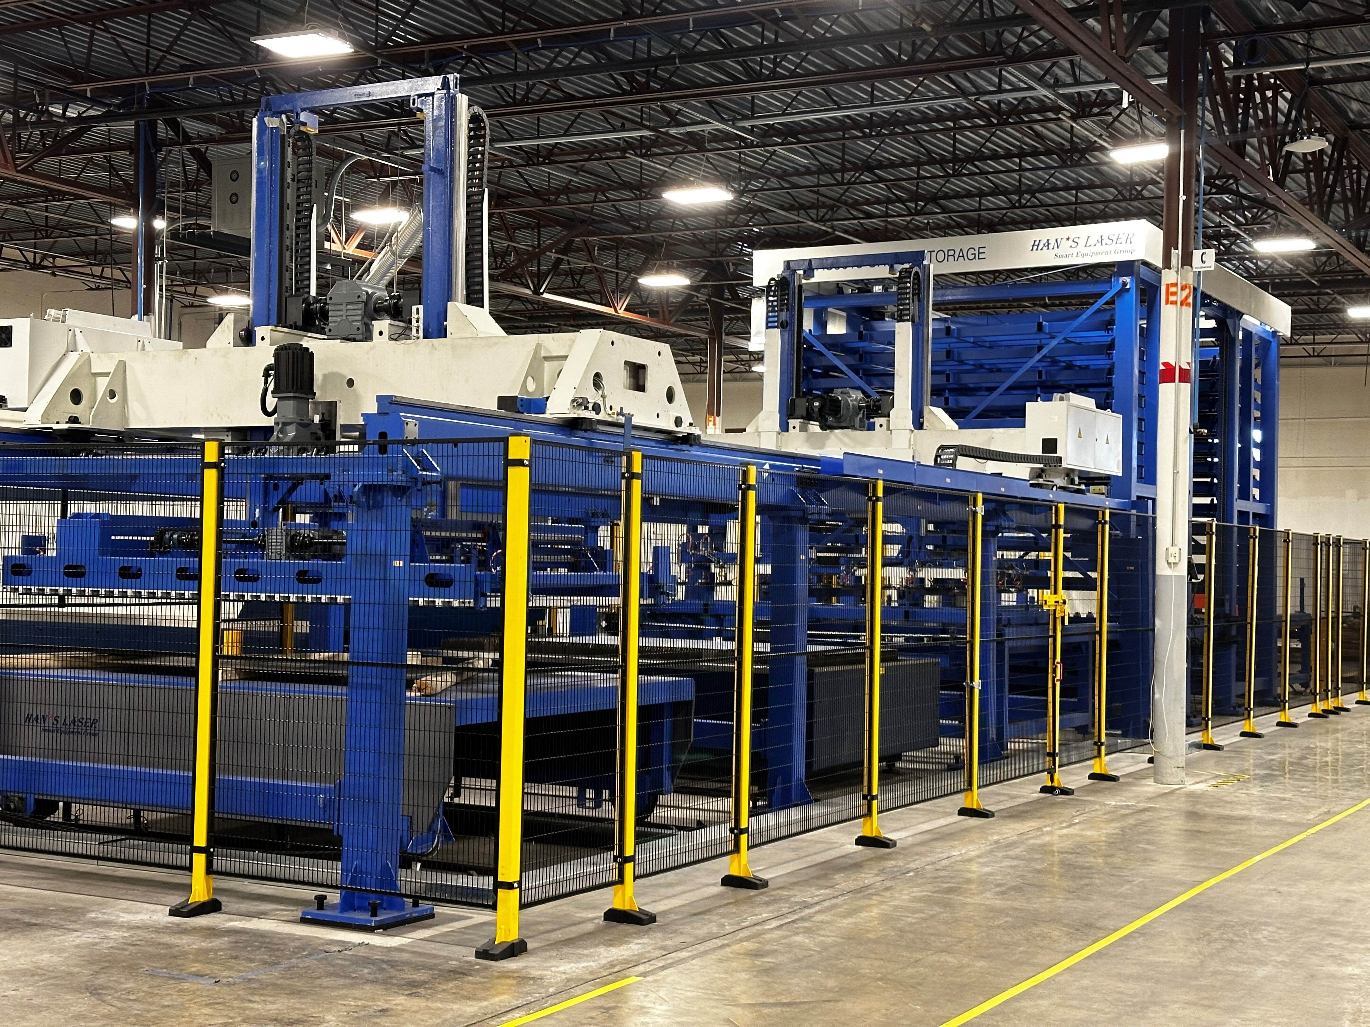

Slide 50
Win the Week
Dennis Buckley
Notes:
Welcome
Thank you for choosing to work at Aagard
Purpose plus values = Aagard experience

Slide 51
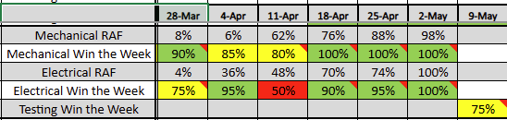
Win the Week
It’s about Performance, Empowerment and Accountability
Meaningful measurements with a short feedback loop
Set the goal based on the work in front of us
  What do we need to do this week to keep the project on track?
Did we meet it?
  100% = Win (let’s celebrate!)
  Less than 100% = Adjust as needed
Reset the goal for next week

Slide 52
People & Culture
Sharlo Meyer
Notes:
Welcome
Thank you for choosing to work at Aagard
Purpose plus values = Aagard experience

Slide 53
Leveling Up
    We want to work with the best
      Spend most of time with high performers
      Better results
      Makes our job as leaders easier
    Combined what we have heard and used from various sources (Aagardized)

Slide 54
Leveling Up
      Culture Fit
        Do they fit in?
      Performance
        Can they do the job?
      Trajectory
        Are they on a path to be successful in their role?
      Keeper Test
        What would our reaction be if they left?

Slide 55
Aagard Talent Assessment

Slide 56
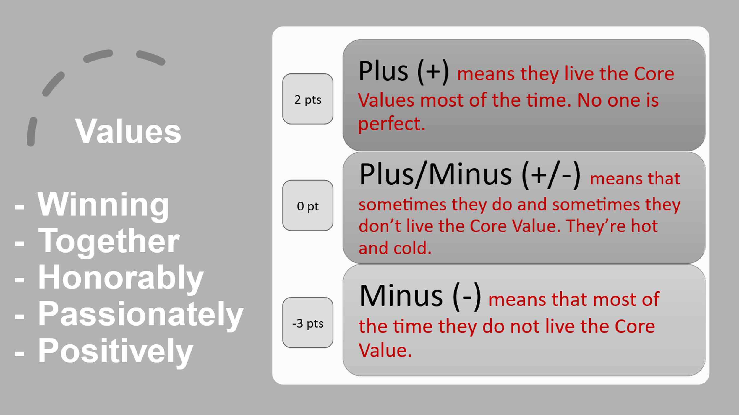

Slide 57
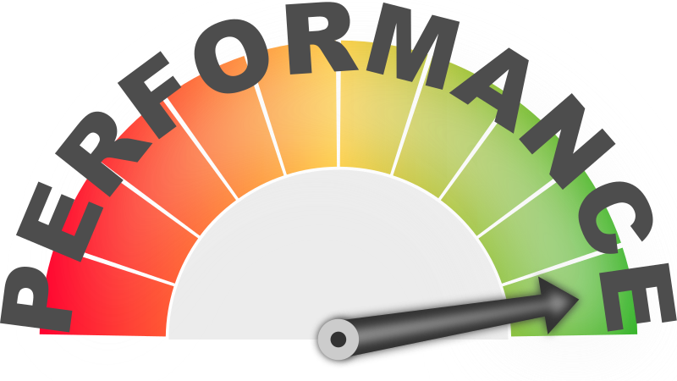
Performance Scale
9-10 Exceeding Expectations
6-8 Meeting Expectations
5 - On the Bubble
1-4 Below Expectations

Slide 58
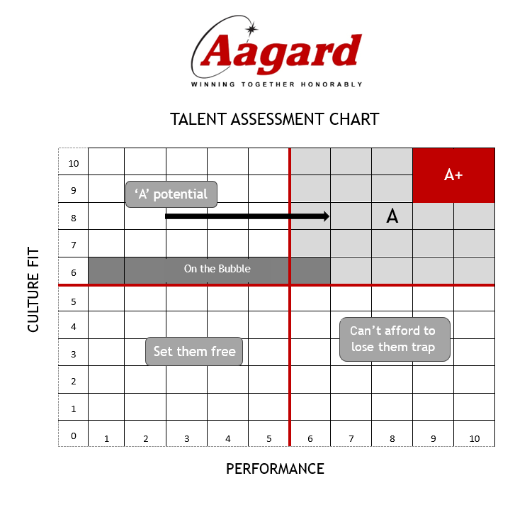

Slide 59
Aagard Talent Assessment Scores
Name | Winning | Together | Honorably | Passionately | Positively | Culture Fit | Performance | Talent Assessment | Path to Success | If gave notice | Action/Coaching Plan
TM1 | 2 | 2 | 2 | 2 | 2 | 10 | 9 | A+ |  | Save
TM2 | 0 | 2 | 2 | 2 | 2 | 8 | 7 | A |  | Save
TM3 | 2 | 0 | 2 | 2 | 2 | 8 | 4 | A potential | Yes | Indifferent
TM4 | 0 | 0 | 2 | 2 | 2 | 6 | 6 | On the Bubble | No | Indifferent
TM5 | 2 | 0 | 0 | 0 | 0 | 2 | 4 | Set them free |  | Relieved
TM6 | 2 | 2 | 0 | -3 | 0 | 1 | 9 | In the Trap |  | Relieved

Slide 60
TM1
TM3
TM2
TM4
TM5
TM6

Slide 61
Keeper Test
      Keeper Test
        What would our reaction be if they left?
          Save Them
          Indifferent
          Relieved

Slide 62
Regrettable vs. Unregrettable Turnover
Regrettable Turnover
Unregrettable Turnover
Voluntary Resignation
Termination
Resignation
Talent Assessment
A+
A
A Potential
Talent Assessment
Set them free
Can’t afford to lose them trap
On the bubble
Keeper Test
Try to Save
Keeper Test
Relieved
Indifferent
On an Upper Trajectory

Slide 63
Regrettable Turnover Metric
Regrettable Turnover > 1 year of service
< 5%
Regrettable Turnover < 1 year of service
< 15%

Slide 64
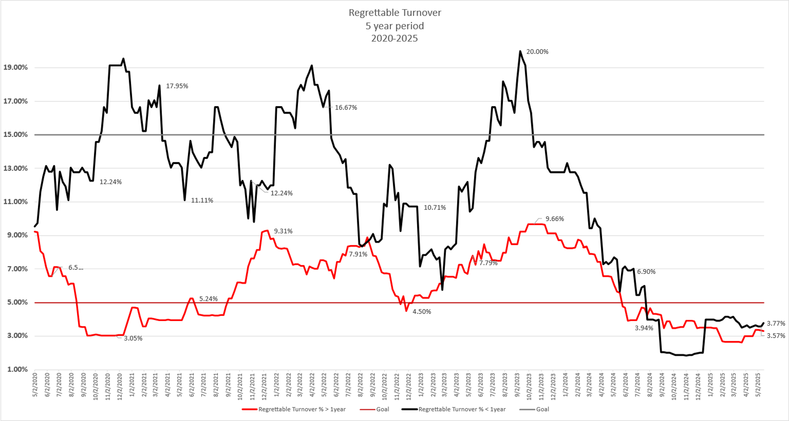

Slide 65
Culture Scorecard
Travis Kloehn
Notes:
Welcome
Thank you for choosing to work at Aagard
Purpose plus values = Aagard experience

Slide 66

Training
Aagard Culture Scorecard
Measurement
  How are we doing in maintaining our culture
Accountability
  Are we all living out what we say we will do
Share
  Share highlights/stories with the rest of the team

Slide 67
Culture Scorecard Expectations
Attend one Team Building Event
Share a What’s Going Well at a Company Meeting
Quarterly Conversations
Safety Walk
Quarterly Team Lunch
Celebrate something
Leadership Training
Affirmation of Appreciation
Spot Award

Slide 68
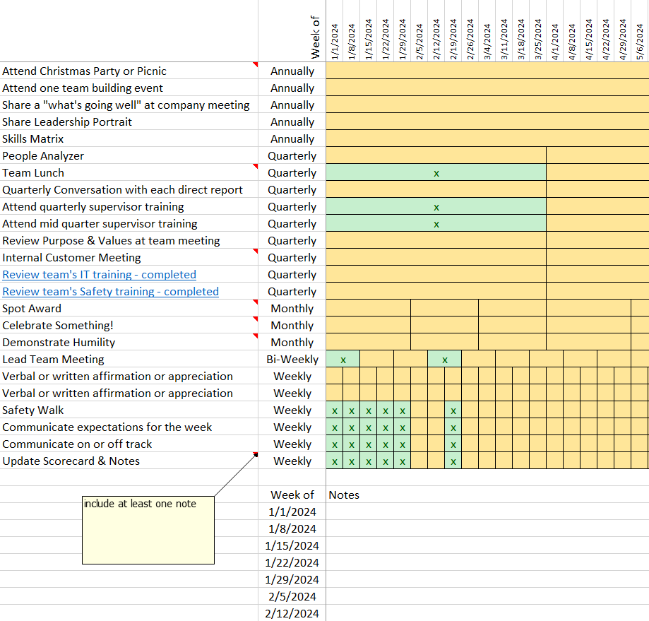
Culture Scorecard Reminder
Not optional
Use as a reminder for the things we have decided are important
Include notes

Slide 69
Helping Our
Customers Win
Winning Together Honorably
Passionately Positively
Notes:
Welcome
Thank you for choosing to work at Aagard
Purpose plus values = Aagard experience

